Slide 1
Lecture-1 Introduction
Abu Saleh Musa Miah(Abid)

Slide 2
Data Structure: Data Structure is a systematic way to organize data in order to use it efficiently
Data
θStructure
Data are values or a set of values
Data item refers to single unit of values
Data item:
Group item :
Data item that can be subdivided into sub item.
Ex Name : First Name, Middle initial and Last Name
Elementary item:
Data item that can not be sub divided into sub item
Ex : PAN card number / Bank Pass Book Number is treated as single item

Slide 3
Collection of data are frequently organized into a hierarchy of fields, records and files
Entity :
Something that has certain attributes or properties which may be assigned values
Values may be numeric or non-numeric
Ex: The employee of an organization
Attributes Name Age Employee Code
value john 33 13 472
Entity with similar attributes ( e.g all employees 1of an organization) form an entity set
Each attribute of an entity set has a range of values [ the set of possible values that could be assigned to the particular attribute]
Information: processed data Data with given attribute or Process Data
Field: is a single elementary unit of information representing an attribute of an entity θ
Record: is the collection of field values of a given entity θ
File: is the collection of records of the entities in a given entity set

Slide 4
Record:
Fixed Length
Variable Length
Nam Age Roll Number Branch
A 17 18 CSE
B 18 19 EEE
Study of Data Structure includes the following three steps
Logical or Mathematical description of the structure
Implementation of the structure on a computer
Quantitative analysis of the structure, which includes determining the amount of memory needed to store the structure and the time required to process the structure

Slide 5
DATA TYPE
is a term which refers to the kind of data that may appear in computation.
Data Type
Built-in Data Type
Derived Data Type
Integers
Boolean (true, false)
Floating (Decimal numbers)
Character and Strings

Slide 6
Derived Data Type
List
Array
Stack
Queue

Slide 7
Data Structure The logical or mathematical model of a particular organization of data
Choice of Model depends on two factor
It of a model depends on two factor must be rich enough in structure to mirror the actual relationships of the data in the real world
The structure should be simple enough that one can effectively process the data when necessary

Slide 8
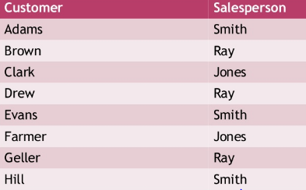
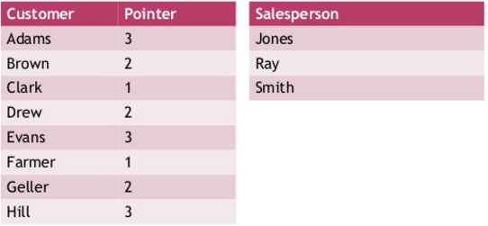
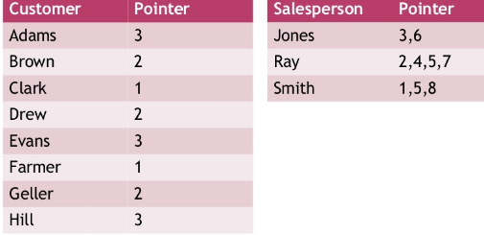

Slide 9
DATSTRUCTURE:
A data structure is a way to logically organize data that specifies:
A set of data elements i.e., a data object and
A set of operations which may legally be applied to elements of this data object.
Operation:
Data appearing in DS are processed by means of certain operation
Particular DS one chooses for a given situation depends largely on the frequency with which specific operations are performed

Slide 10
Major Operation:
Traversing: Accessing each record exactly once so that certain items in the record may be processed [ Also known as Visiting the record]
Searching: Finding the location of the record with a given key value, or finding the locations of all record which satisfy one or more conditions
Inserting : Adding a new record to the structure
Deleting : Removing a record from the structure

Slide 11
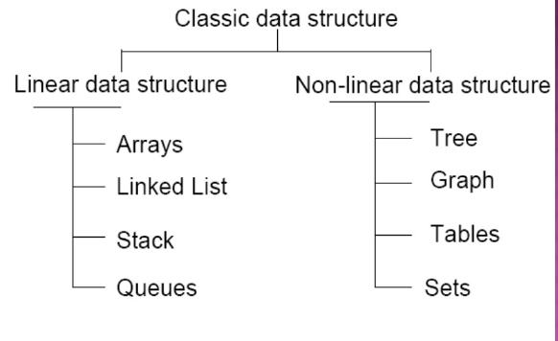
Classification of Data Structure:

Slide 12
Array:
Following terms are the foundation terms of a data structure.
Interface − Each data structure has an interface. Interface represents the set of operations that a data structure supports. An interface only provides the list of supported operations, type of parameters they can accept and return type of these operations.
Implementation − Implementation provides the internal representation of a data structure. Implementation also provides the definition of the algorithms used in the operations of the data structur

